Slide 1
Analyzing the Drivers of CO₂ Emissions: A Multi-Factor Analysis
Presented by: Ravina Ravina

Slide 2
Project Overview & Context
• Part 1 identified top CO₂ emitters (China, USA) • Shifted to CO₂ emissions per capita for fair comparison • Key drivers were unclear • Machine Learning used to identify key influencing factors
Key Question: What factors drive CO₂ emissions, and what is the relationship with renewable energy?

Slide 3
Data Refinement & Preparation
Data Integration Merged two World Bank datasets: • CO₂ emissions data • Renewable energy consumption data
Data Cleaning • Removed small territories & irrelevant regions • Handled missing values using median imputation • Converted variables into proper numeric format
Time Filtering • Original data: 1960–2022 • Final dataset: 1990–2020
Final Dataset • 198 countries included

Slide 4
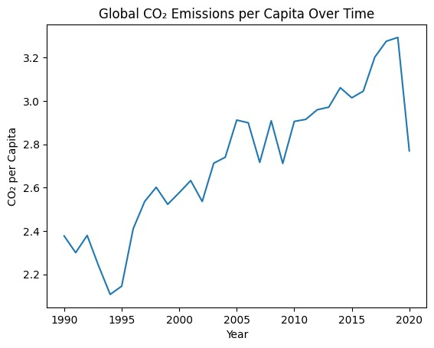
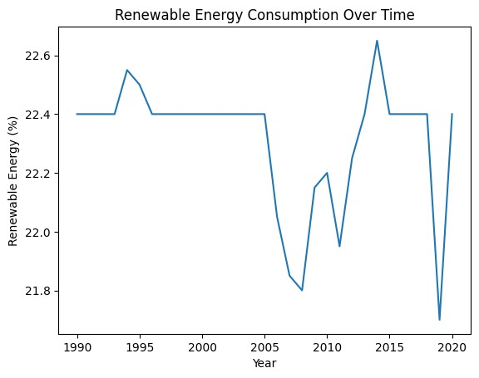
CO₂ vs Renewable Energy Trends Over Time
CO₂ Emissions Trend
Renewable Energy Trend

Slide 5
Models: Baselines & Advanced
Baseline models
Advanced models
Model | R² Score | MAE | RMSE
Linear Regression | 0.568 | 9.223 | 40.793
Decision Tree | 0.999 | 0.514 | 1.575
Model | R² Score | MAE | RMSE
Random Forest | 0.9988 | 0.649 | 2.114
Gradient Boosting | 0.9972 | 2.010 | 3.263
Model | Train R² | Test R²
Linear Regression | 0.666 | 0.568
Decision Tree | 1.000 | 0.999
Model | Train R² | Test R²
Random Forest | 0.9997 | 0.9988
Gradient Boosting | 0.9987 | 0.9972
Final Baseline: Linear Regression Final Model: Random Forest

Slide 6
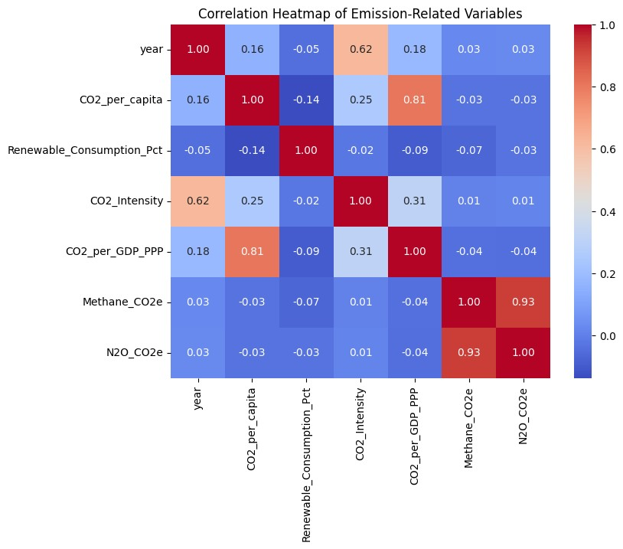
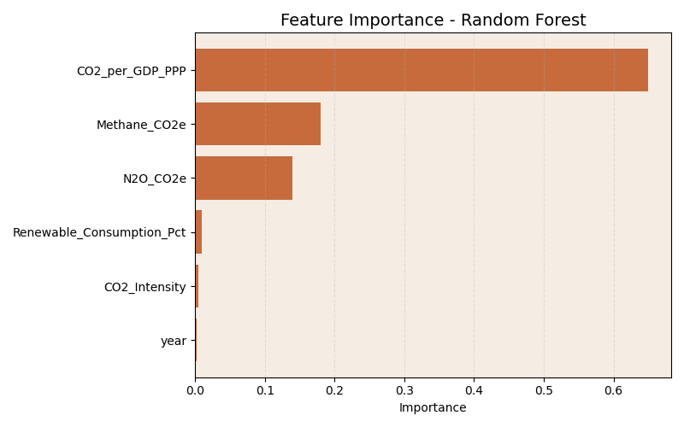
Correlation Analysis Feature Importance
Key Relationships
• Strong positive: CO₂ vs CO₂ per GDP • Weak negative: Renewable vs CO₂ • Strong relation: Methane & N₂O • Moderate: CO₂ intensity impact
Key Insights
• Dominant factor: CO₂ per GDP • Moderate role: Methane and N₂O • Weak influence: Renewable energy • Negligible impact: Year and CO₂ intensity

Slide 7
Reduced Features Experiment: Role of Renewable Energy
Goal
Evaluate if renewable energy alone can explain CO₂ emissions
Methodology
Removed key economic factors (CO₂ per GDP, intensity)
Trained model using only limited features
Results
R² dropped drastically from 0.9988 → 0.19

Slide 8
Hypothesis Testing: Renewable Energy’s Impact
Hypotheses:
Null Hypothesis (H₀): Renewable energy consumption has no significant relationship with CO₂ emissions per capita. Alternative Hypothesis (H₁): Renewable energy consumption has a significant relationship with CO₂ emissions per capita.
Findings
• Correlation: -0.137 (weak negative) • p-value: 3.94 × 10⁻²⁷

Slide 9
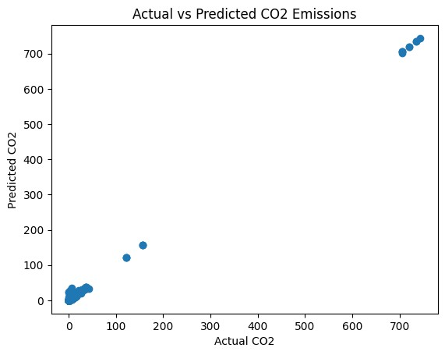
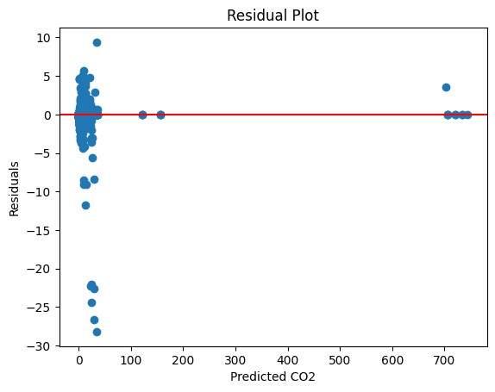
Visual Model Evaluation
Actual vs Predicted Plot
Residual Plot Analysis
Points close to line → high accuracy
Errors near zero → good model fit

Slide 10
Hyperparameter Tuning
Best Parameters:
• n_estimators = 200 • max_depth = None • min_samples_split = 2 • min_samples_leaf = 1
Optimized Model Performance:
• CV Score = 0.9496 • R² = 0.9989 • MAE = 0.6377 • RMSE = 2.047
Tuning improved model performance and ensured stable generalization.

Slide 11
ANN Performance Improvement & Model Comparison
1. ANN (Before Tuning)
• R² = -0.006 • MAE = 10.95 • RMSE = 62.28 • Very poor performance
2. ANN (After Tuning)• R² = 0.159 • MAE = 12.24 • RMSE = 56.93 • Slight improvement but still low accuracy
Final Comparison:
Model | R² Score | MAE | RMSE
Linear Regression | 0.568 | 9.22 | 40.79
Random Forest | 0.999 | 0.65 | 2.11
ANN (Tuned) | 0.159 | 12.24 | 56.93

Slide 12
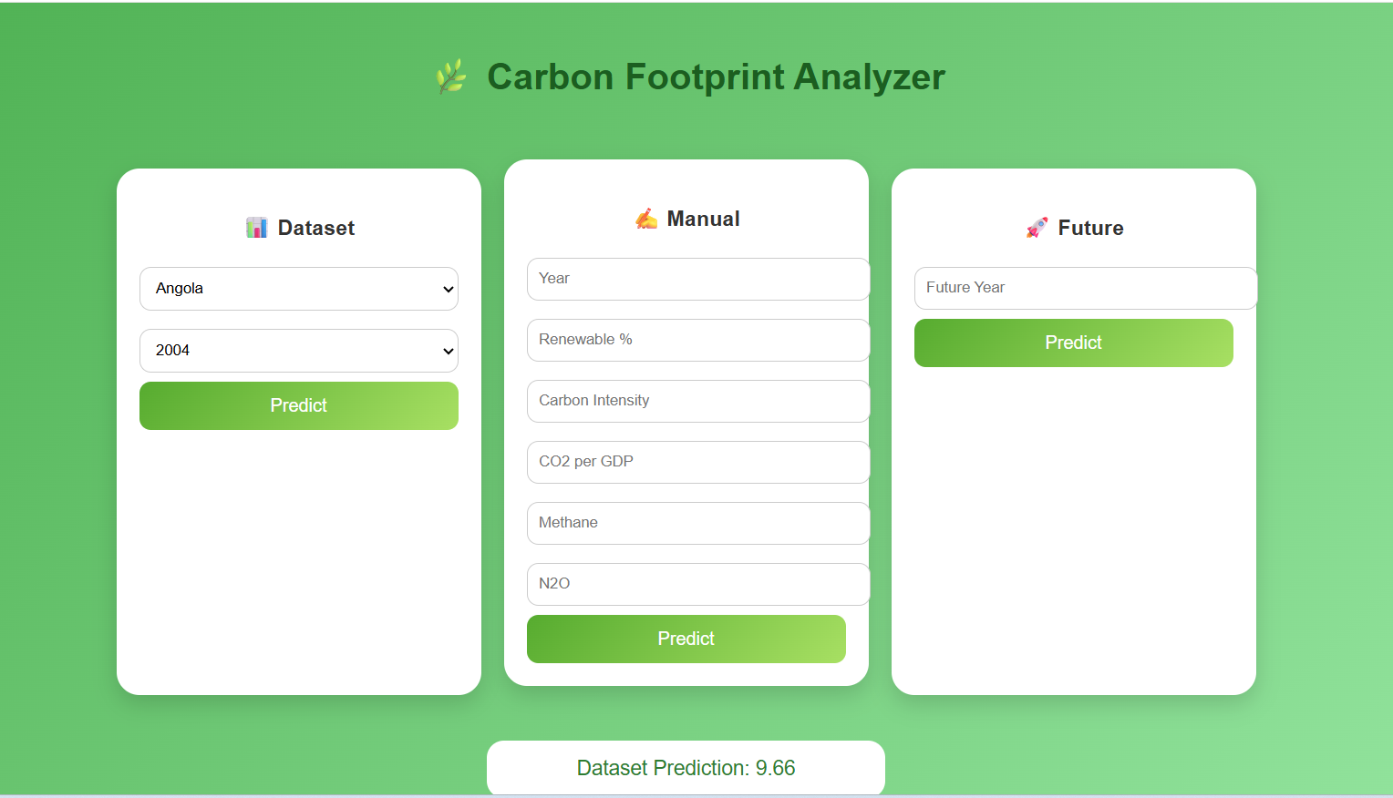
Model Deployment (Web Application)
Real-world application of the machine learning model
• Flask-based web application • User inputs features • Predicts CO₂ emissions • Uses Random Forest model

Slide 13
Key Insights from model Analysis
1. Model Outperformance
Random Forest significantly outperformed Linear Regression, capturing complex non-linear patterns.
2. Dominant Predictor
CO₂ per GDP (PPP) is the most influential feature, highlighting the role of economic carbon efficiency.
3. Greenhouse Gas Impact
Methane (CH₄) and N₂O show moderate contribution alongside economic factors.
4. Economic Carbon Intensity
Economic indicators are more critical than renewable energy in explaining CO₂ emissions.

Slide 14
World Bank vs Our Findings
World Bank Insights
• Industrial and large economies contribute the most to global CO₂ emissions.
Our ML Findings
• Carbon intensity indicators are the strongest predictors. • Renewable energy alone has limited direct impact.
Conclusion:
Economic structure and carbon efficiency are the key drivers of CO₂ emissions, highlighting the need for effective decarbonization strategies.

Slide 15


